Slide 1
SE 577 Software Architecture Architectural Modeling

Slide 2
Modeling is a technique used to tame complexity
Models are used to capture abstractions of complex systems to make them easier to reason about.
What are the key questions that you need to be able to answer
Identify the optimal level of abstraction at which to model
Identify what “objects” will be modeled and the types of interactions you will model
Identify the possible states of the system including both system states and the state of their runtime environment
Identify how interactions will change (if at all) over time

Slide 3
So what are software architecture models?
Architecture models capture the foundational design decisions about a system.
An architecture model is an artifact that captures these decisions
These models serve as documentation that can be consumed by various stakeholders

Slide 4
Why is the ability to document architecture important?
Its important to be able to document an architecture to reason about its design for a number of reasons…
Program Understanding – we need to make modifications to the system, where would the modifications go, how long would they take, how much would they cost
Explaining the operation of the system to stakeholders – how does the system work, what are its major features, why should you use this system versus a competitors solution
Providing a common document to capture the high-level design of the system that can be used to make important management and technical decisions
Measuring technical health and technical debt – how far does the “as built” system deviate from the “as designed” architecture?

Slide 5
Modeling choices are important!
The choice of what to model is important!
This activity takes time and costs money so picking what to model becomes a critical activity
The choice of how detailed your models are are important!
What stakeholders are you trying to influence?
How much detail is needed to describe the architecture to the stakeholders?
Does the model describe the design, or is the model intended to influence a decision?
The choice of what notation is used to document your architecture is important!
Should you use formal, or semi-formal notations

Slide 6
Modeling is about documenting key architecture and design decisions!
A model is an artifact that captures a number of different design decisions used to establish the overall system architecture
This activity takes time and costs money so picking what to model becomes a critical activity
Key things to consider when modeling
What architectural decisions and concepts should be modeled,
At what level of detail, and
With how much rigor or formality
Adapted From Software Architecture, Foundations, Theory and Practice

Slide 7
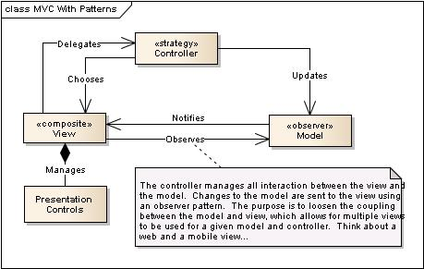
What do we document in a model?
Components
Connectors
Interfaces (including constraints)
Decisions and Rational
Structural, Runtime and Behavioral Constraints
Remind you of the definition of software architecture?

Slide 8
Thinking about models…
To experiment
To clarify
To understand
To analyze
To evaluate
Reason for Modeling
What is the purpose of the model, and who is the model for?
What to Model
How to Model
Structure
Transformations
State
Inputs and Outputs
Textual
Graphical
Formal / Mathematical
Adapted From: https://www.cl.cam.ac.uk/teaching/1112/SWDesign/softwaredesign01.pdf

Slide 9
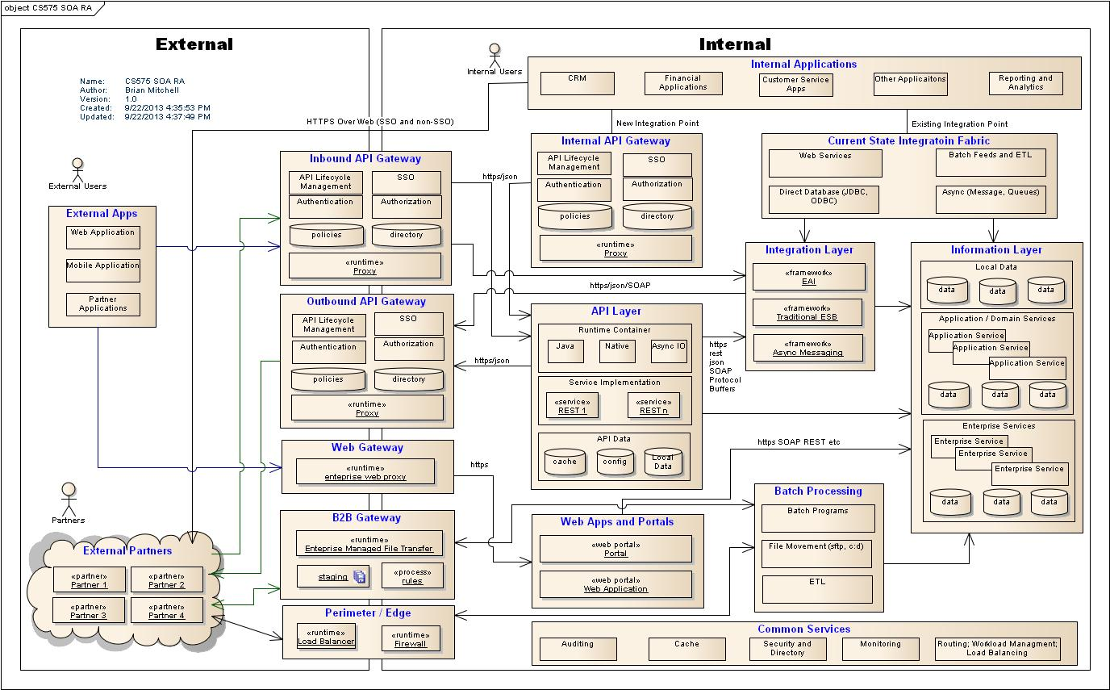
Example: What are some of the key aspects of this model?

Slide 10
Modeling the different views – Static and Dynamic
Static models describe the structure of the system
These structures generally do not change over time
Capture the topology of the system components:
can be software component relations – uses/inherits
Can be runtime component relations – sends message to over HTTP
Can be deployment component relation – this software is deployed to this server…
Dynamic models capture the behavior of the system during runtime
The important thing to capture is change is being managed over time
State of the components
Data flow over the connectors

Slide 11
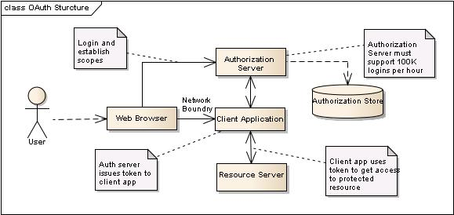
Static Model View (Example: oAuth)
Is this view useful to discuss the components associated with managing the oAuth protocol (functional and non-functional)?

Slide 12
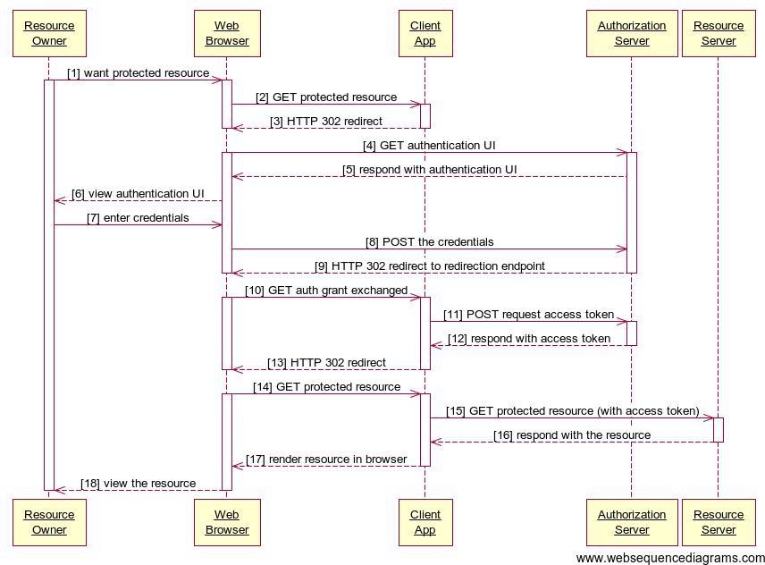
Dynamic Model View (Example: oAuth)
Is this view useful to discuss how the components implementing the oAuth protocol work together?

Slide 13
Possible problems using multiple views to model software architectures
Modeling a realistic software architecture using a single view is not practical
Too complex
Different concerns that don’t belong together – static, dynamic, deployment
Key challenge is to ensure that all the different views are consistent
Might be hard to find these issues
Direct – one diagram states two servers, another states three servers
Indirect – one view is at a higher level than another and the refinement introduced inconsistencies
Structure vs Dynamic – structures don’t support dynamic requirements
Functional vs Non-Functional – The structure does not support the non-functional requirements

Slide 14
Modeling (Documentation) Objectives
Useful now, represents the best knowledge of key architecture and design decisions
Is contextual to the key problems or design decisions that need to be made
Is appropriate to a targeted stakeholder
Longer term, captures key decisions made that are useful for maintenance
As little as possible, documentation requires maintenance

Slide 15
Where to Start? Consider what needs to be modeled!
The hardest part of reconstructing an architecture is selecting what needs to be modeled …
Components – hierarchical description of the major subsystems
Connectors – connections between the components
Interfaces – the protocols governing the connectors, or the properties managed by the clients
Patterns and Styles – are there any interesting patterns or styles used in the architecture that should be documented?
Rationale – reasoning behind decisions of the aspects we chose to model – are they important to stakeholders? are they critical to the understanding of the system?
Constraints – what dependencies don’t we want to have in the solution

Slide 16
Where to Start? Consider what needs to be modeled!
Think about what is important to show to promote an understanding of the architecture…
Static aspects are things that do not change as the system runs, and
Dynamic aspects are things that do change, manage important state, or are sequence dependent
Platform aspects are things where the runtime or deployment decisions play an important part of the architecture – load balancers, proxy servers, etc.

Slide 17
What about redocumenting existing systems from the source code
How do we find things that we want to model…
Look at the code
Source code analysis tools
Class/package structure
Build / configuration management information
Test cases – what is being tested – that must be important
Directory structures
Naming conventions
What do we know about the system
What are the main features
How are they exposed to the users
Build / configuration management information
Test cases – what is being tested – that must be important
Directory structures
Naming conventions
Non-functional aspects

Slide 18
Think about what story that you want to tell to identify important things that need to be modeled
Think about how you were taught to write stories in elementary school:
Who? Who is your stakeholder or target audience
What? What is the key message you are trying to get across
Why? Why is it important
Where? Where are the most important parts – think scale, security, etc
When? When do key events happen?
How? How does it work?
How Much? How much impact does the system have on an existing landscape?

Slide 19
And the outcome you want to achieve
Why do I create a Model / View:
Drive stakeholder clarity
Making quality / informed decisions
Forcing others to make decisions
Being transparent around the solution – what it is and what it is not
Being opinionated around constraints
Show alignment, and possible misalignment with enterprise or industry standards

Slide 20
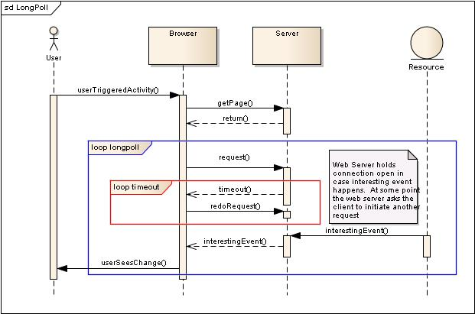
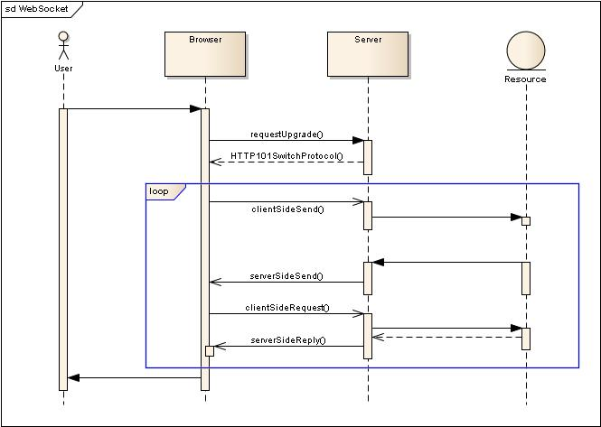
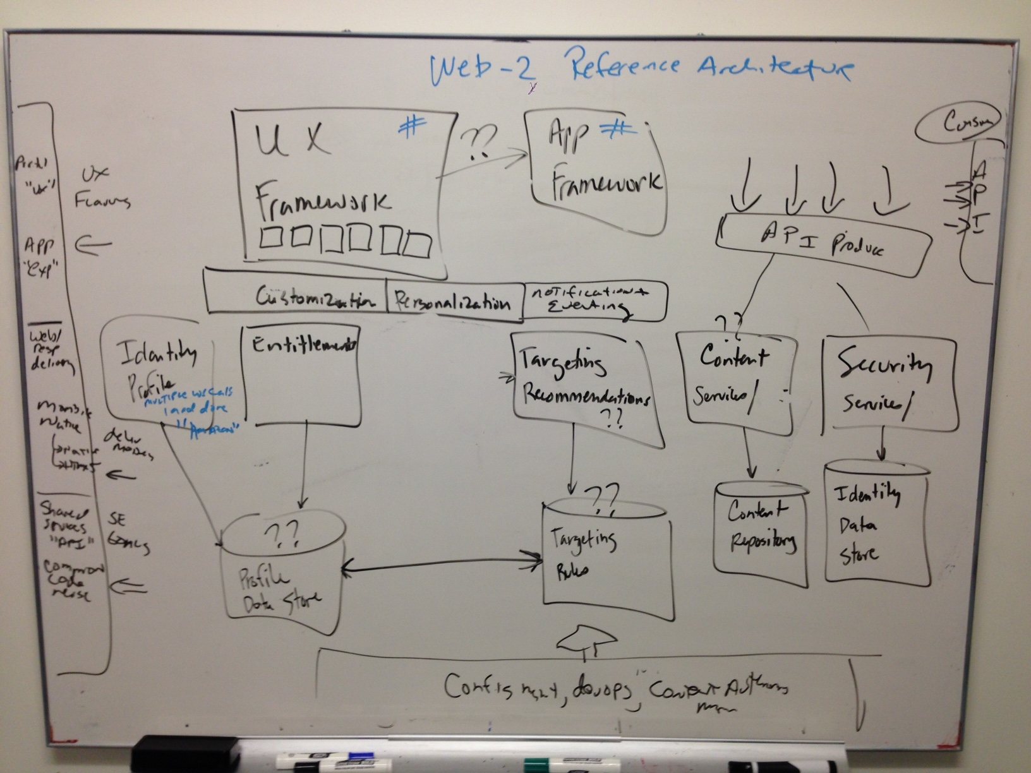
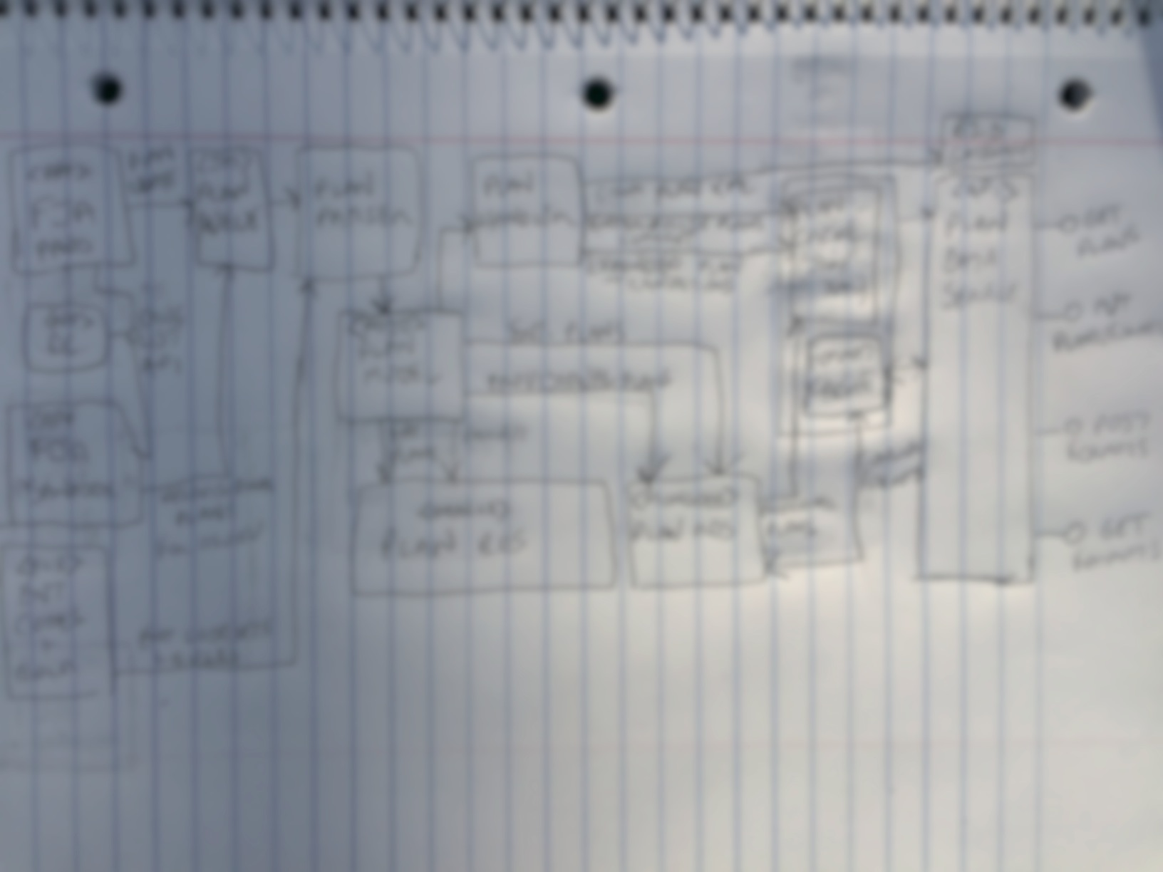
Be clear on the outcome you are trying to accomplish
What are the major Components?
What is being impacted?
Who are the important stakeholders?
How does this complex behavior work?
How do we message what needs to change?
Is this even feasible?

Slide 21
MOST IMPORTANT CONCEPT IN THIS LECTURE
At the end of the day, a model is a quasi-useless artifact unless:
It helps you as the architect, or your architecture team decompose the complexity of the problem domain, or
Its purposefully targeted at one or more key stakeholders to facilitate alignment on:
Decision that have, or will need to be made on the solution to acheive its functional or non-functional requirements
Aspects around tradeoffs driven by constraint balancing that require agreement
Agreement related to technical debt that require socialization
Agreement around technical stack or deployment options that impact or constrain engineering staff
Alignment around which decisions need to be made when, even if those decisions have not been made yet.

Slide 22
Describing Architectures
Formal Approaches
Architectural Description Languages
Many to date
Informal/Semi-Informal Approaches
UML Notation – Simple and known by a broader community
UML is missing architecture semantics
Lines and Boxes (complemented) with natural English
Other Domain Specific Notations – C4

Slide 23
Method 1 – Formal Architecture Description Languages; Pipe and Filter Example
Style PipeFilter
Filter
Input Port
Pipe
Output Port
Binding
Simple PipeFilter System
Grep Filter
Merge and Sort
Splitter Filter
Merge
Sort
Lets see how we can formally specify this next ->

Slide 24
Method 1 – Formal Architecture Description Languages; Pipe and Filter Example
Family PipeFilter = {
Port Type OutputPort;
Port Type InputPort;
Role Type Source;
Role Type Sink;
Component Type Filter;
Connector Type Pipe = {
Role src : Source;
Role snk : Sink;
Properties {
latency : int;
pipeProtocol: String = …;
}
};
};
System simple : PipeFilter = {
Component Splitter : Filter = {
Port pIn : InputPort = new InputPort;
Port pOut1 : OutputPort = new OutputPort;
Port pOut2 : OutputPort = new OutputPort;
Properties { … }
};
Component Grep : Filter = {
Port pIn : InputPort = new InputPort;
Port pOut : OutputPort = new OutputPort;
};
Component MergeAndSort : Filter = {
Port pIn1 : InputPort = new InputPort;
Port pIn2 : InputPort = new InputPort;
Port pOut : OutputPort = new OutputPort;
Representation {
System MergeAndSortRep : PipeFilter = {
Component Merge : Filter = { … };
Component Sort : Filter = { … };
Connector MergeStream : Pipe = new Pipe;
Attachments { … };
}; /* end sub-system */
Bindings {
pIn1 to Merge.pIn1;
pIn2 to Merge.pIn2;
pOut to Sort.pOut;
};
};
};
Connector SplitStream1 : Pipe = new Pipe;
Connector SplitStream2 : Pipe = new Pipe;
Connector GrepStream : Pipe = new Pipe;
Attachments {
Splitter.pOut1 to SplitStream1.src;
Grep.pIn to SplitStream1.snk;
Grep.pOut to GrepStream.src;
MergeAndSort.pIn1 to GrepStream.snk;
Splitter.pOut2 to SplitStream2.src;
MergeAndSort.pIn2 to SplitStream2.snk;
};
}; /* end system */

Slide 25
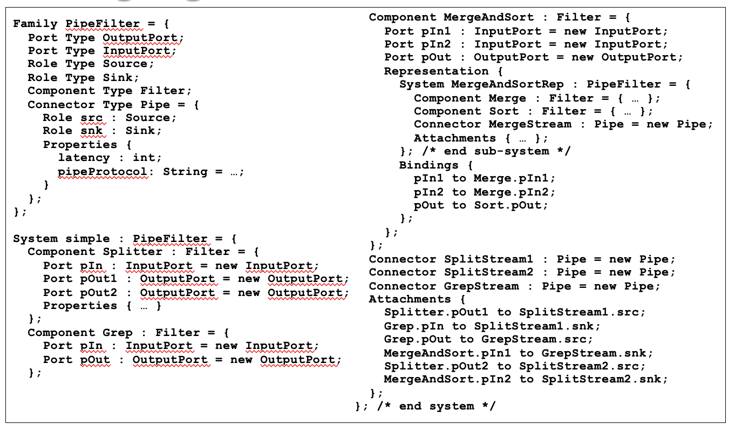
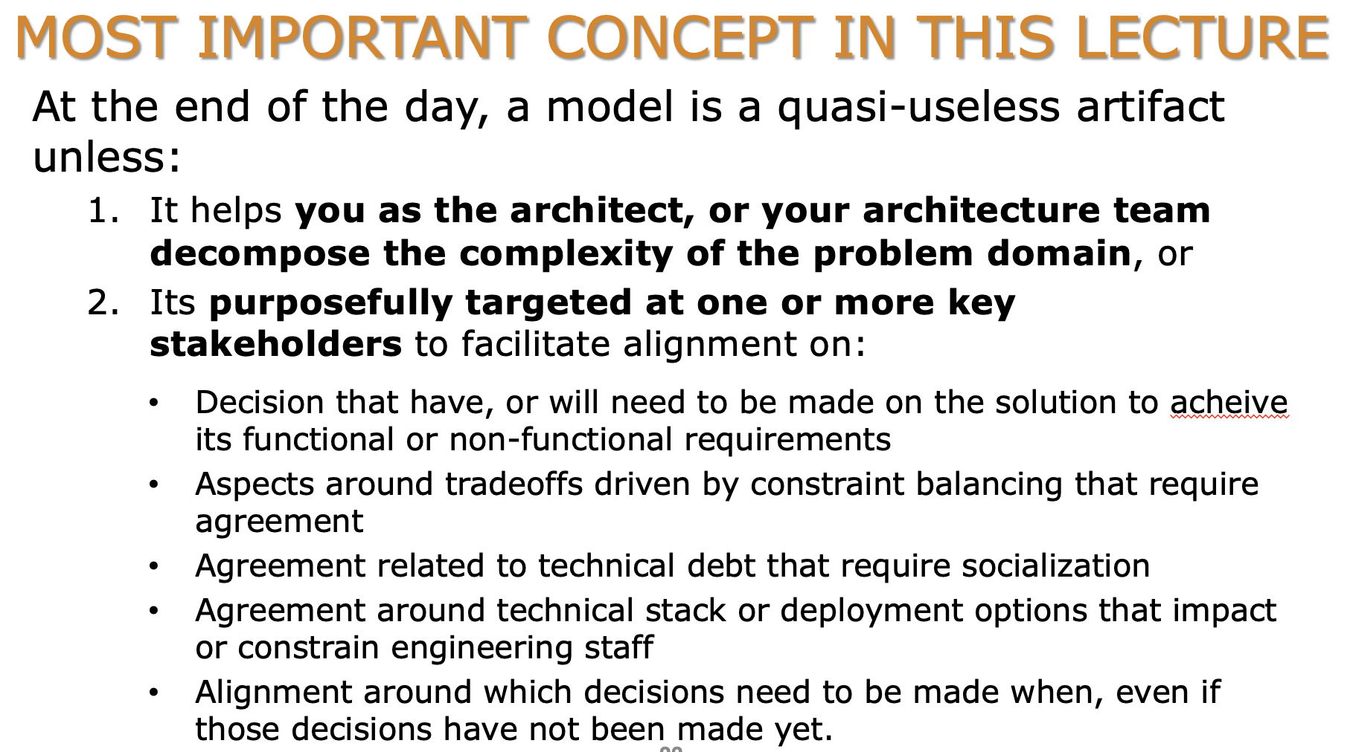
Thoughts on Formal Architecture Modeling
How does this….
Help Achieve any of this?
My personal view – I have never found any instance where formal methods for architecture modeling have made sense. However, I think the sweet spot for formal methods is in design verification, especially for safety critical systems. I like the work of Wane Hillel in this space, ref: https://www.hillelwayne.com/tags/formal-methods/. See his work on TLA+ and Alloy - https://www.hillelwayne.com/projects/

Slide 26
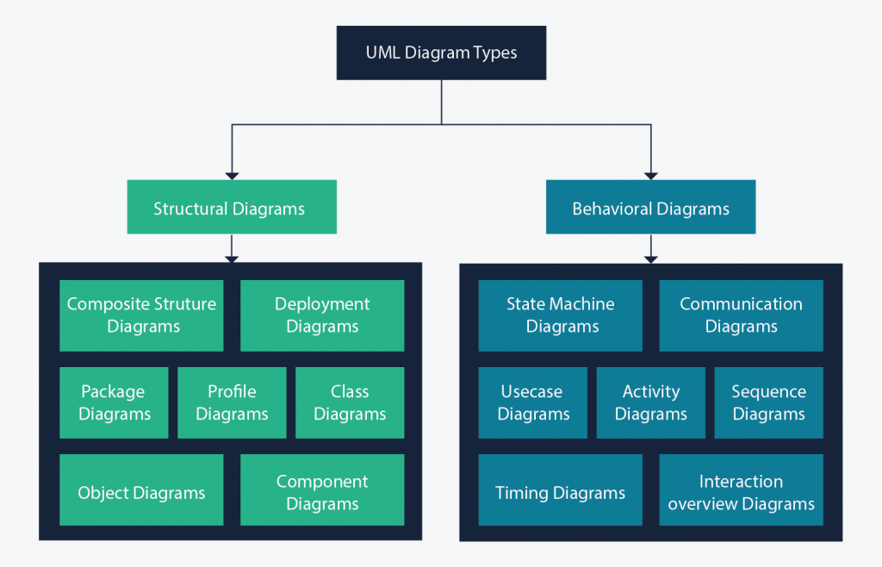

UML as a Modeling Language for Architecture
UML is a semi-formal visual language which specifies 14 different types of diagrams that cover both static and dynamic modeling needs
While UML is expressive enough to support architecture modeling, its primary abstractions are geared towards source code components and connectors vs architectural ones.
https://creately.com/blog/diagrams/uml-diagram-types-examples/

Slide 27
Example: UML to model a banking service
UML Basic Component Diagram with Stereotypes

Slide 28
Another UML Example
Adding Custom Stereotypes – Service, Service Connector, Service Interface

Slide 29
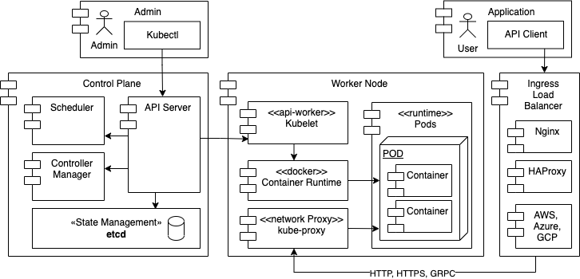
Another UML Example – Something more realistic Kubernetes v1

Slide 30
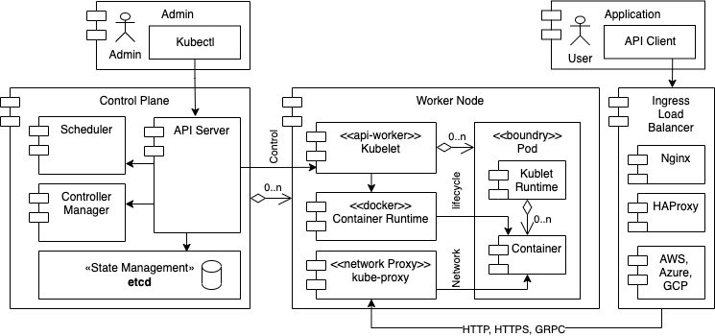
Another UML Example – Kubernetes v2
Notice the similarity to the first version of the model. Just some notation changes. How are they helpful to promote understanding of the architecture?

Slide 31
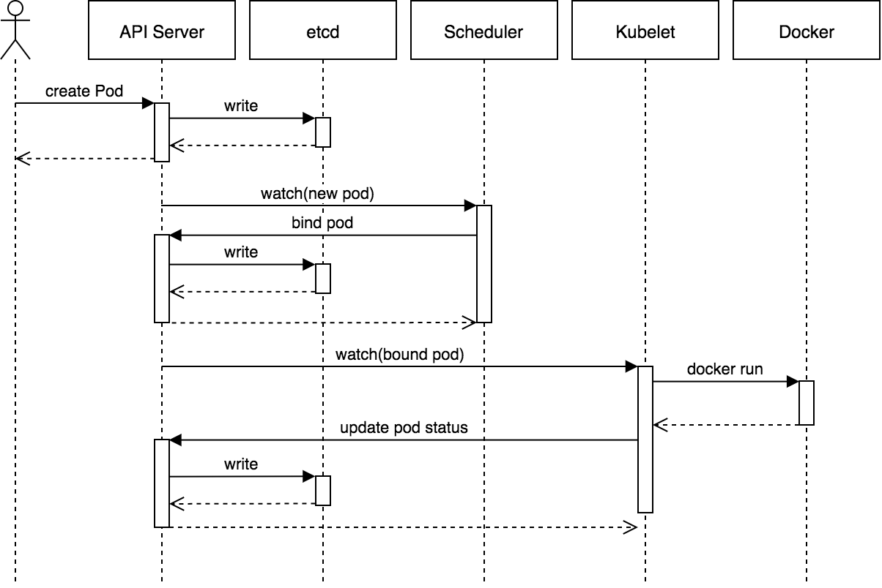
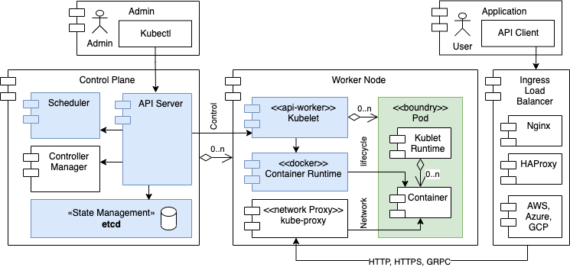
Kubernetes Pod Lifecycle – Behavioral Example
Don’t forget about modeling dynamic behavior, the how the system will behave at runtime is also very important

Slide 32
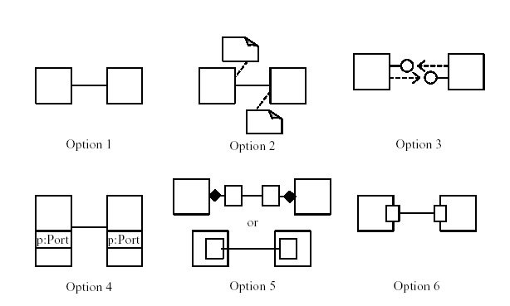
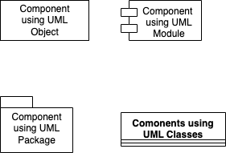
For UML to be used for Architecture Modeling, Team Standards must be established
With UML there are multiple ways the same abstractions can be represented
ports as annotations
generic (line-and-box)
ports as interfaces
4 Different Ways to Represent Architecture Components
ports as class attributes
ports as classes
ports as classes (shown on boundary)

Slide 33
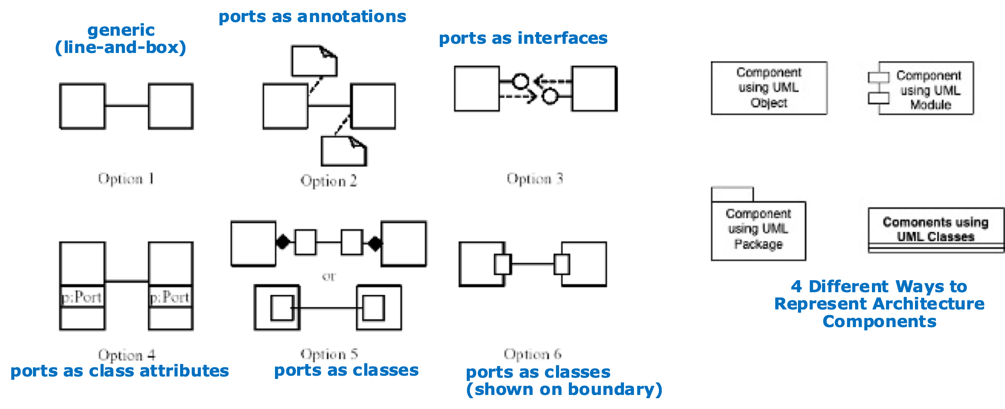
For UML to be used for Architecture Modeling, Team Standards must be established
Need to agree on notational conventions
Does this make UML better/worse that informal modeling techniques?

Slide 34
UML as a Modeling Language for Architecture
The Good
UML is “somewhat-widely” known
There is commercial tool support for UML
UML is extensible
The Not-So Good
UML is a language of design, and not architecture
Many of UML abstractions are really constructs that you see in object-oriented programming languages
UML has many options to do basically the same thing, how to you get consistency?

Slide 35
Using informal lines and boxes to model architecture
In this approach a diagraming tool such as Microsoft Visio, Draw.io or Omnigraffle is used to document the architecture views
Tends to create the “best looking” views given that there is no limitation to the artwork that can be applied to the components and connectors.
Probably the most popular approach to document architectures
But there are challenges:
There is a lack of rigor over the component and connector vocabulary (Legends can help)
They tend to be pictures, and difficult to get value over managing the views in a model repository – for example – there is limited opportunity to share metadata between diagrams
Hard to deal with versioning and change – “Is this the latest view?”
Impossible to detect inconsistencies between models

Slide 36
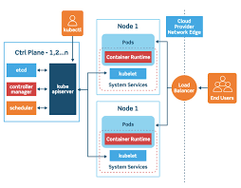
So why are informal line-and-box drawings so popular for modeling architectures?
How does this….
Help Achieve any of this?
Unlike formal methods, informal lines and boxes can be heavy customized to meet the objective of the model. That said, its basically just drawing and care must be placed on the objective of the model, or else it will end up being quasi-useless architecture art

Slide 37
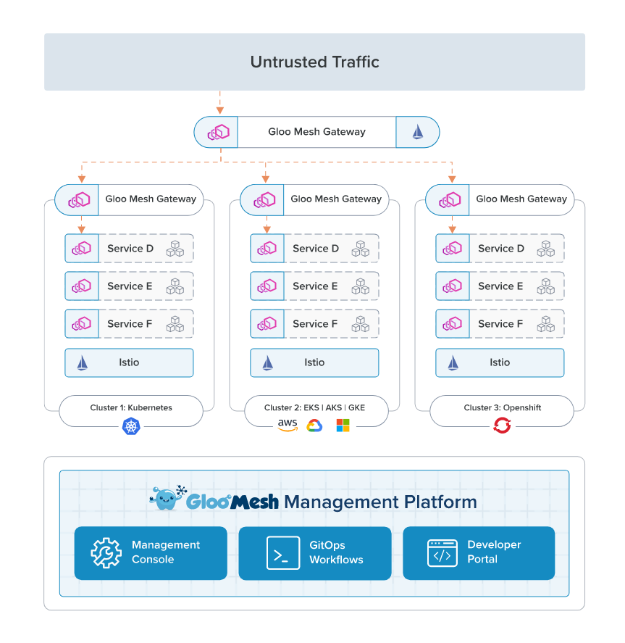

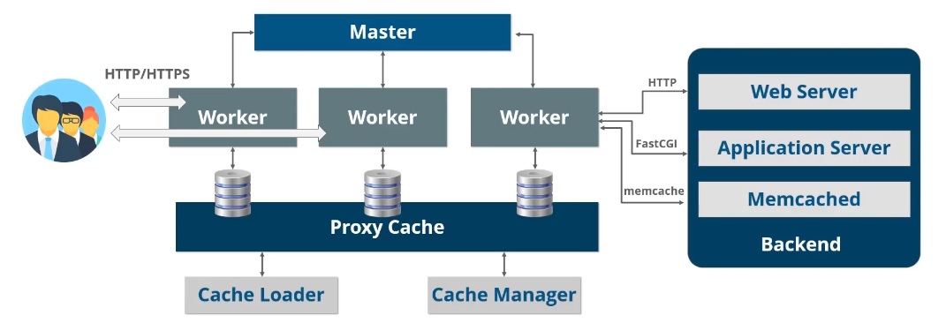

Informal Line and Box Examples – “Marketecture”

Slide 38
Informal Line and Box Examples – Architecture
The key objective of this architecture model wasn’t to really show anything of technical architecture significance… Its real objective was to to highlight to executive management the size of the impact of implementing this solution. The key to this model is the legend to highlight what is new, changed or deprecated.
This model also uses other techniques such as the size of the boxes to highlight relative magnitude
Terrible model to convey architecture, great model to convey to a stakeholder why what we are doing is complex and expensive

Slide 39
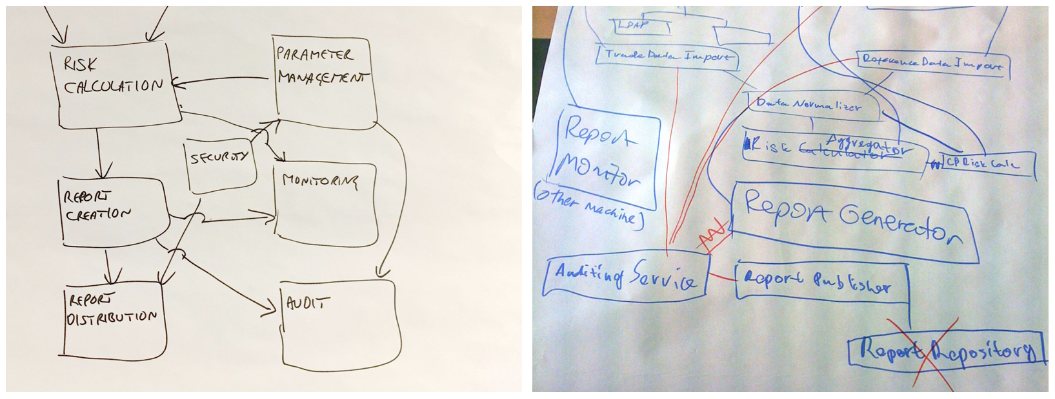
Informal Line and Box (Bad) Examples

Slide 40
Summary: Using informal lines and boxes to model architecture
Clearly the most popular approached used to model architectures
Have to very clearly focus on the intended value or impact of the model at the risk of it becoming just artwork
Remember that things that help improve understanding should be incorporated into the model:
Legend to highlight the lines and the boxes meaning or any special color coding
Callout text boxes, or annotate important areas of the model with callouts like (1) and then supplement with a textual description.
Avoid distribution over email, or via shared drives. We have found value creating and meaning these artifacts in shared wikis like Confluence or via GitDocs.
Make sure that important diagrams are tagged so that they can be searched for and located

Slide 41
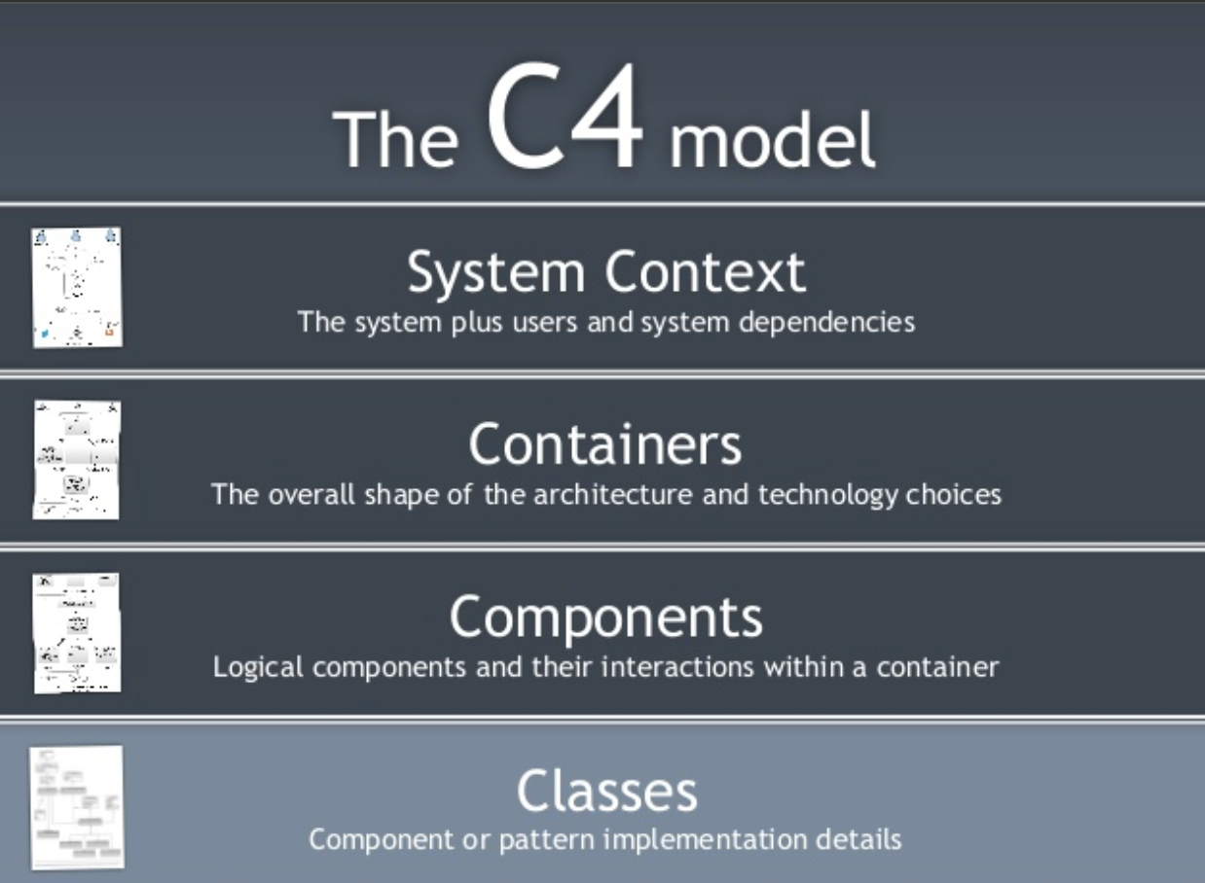

Finding the balance - the C4 model
https://c4model.com/
https://simonbrown.je/
Material on C4 is derived from the many online resources created by its inventor – Simon Brown

Slide 42
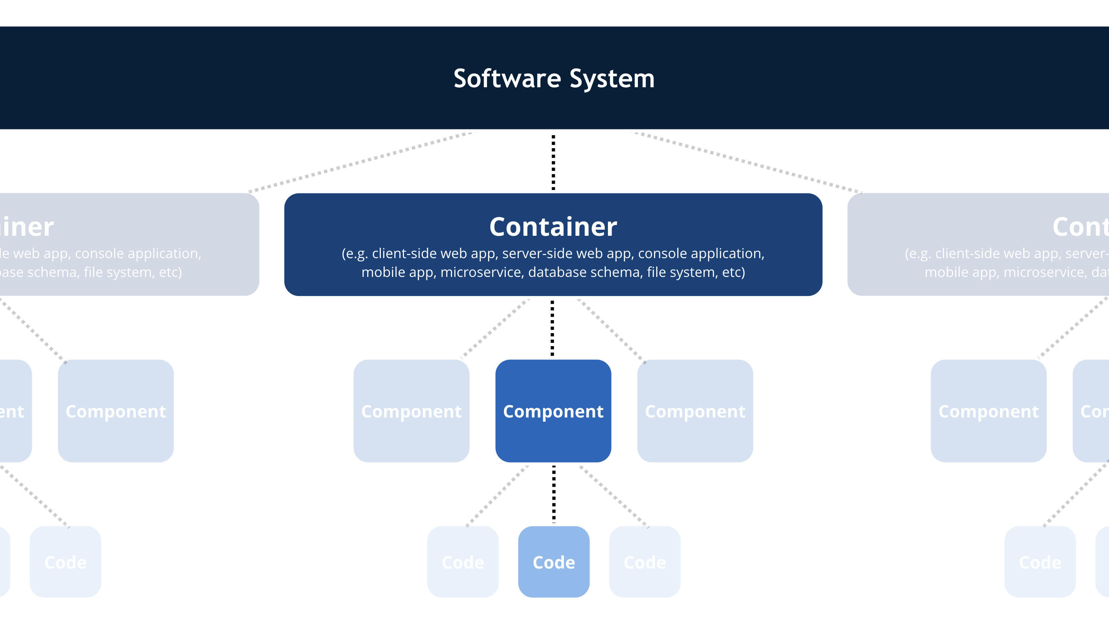
C4 imposes an opinionated structure on modeling
A software system is made up of one or more containers (web applications, mobile apps, desktop applications, databases, file systems, etc), each of which contains one or more components, which in turn are implemented by one or more code elements (e.g. classes, interfaces, objects, functions, etc).

Slide 43
The key attributes in C4 are related to each other

Slide 44
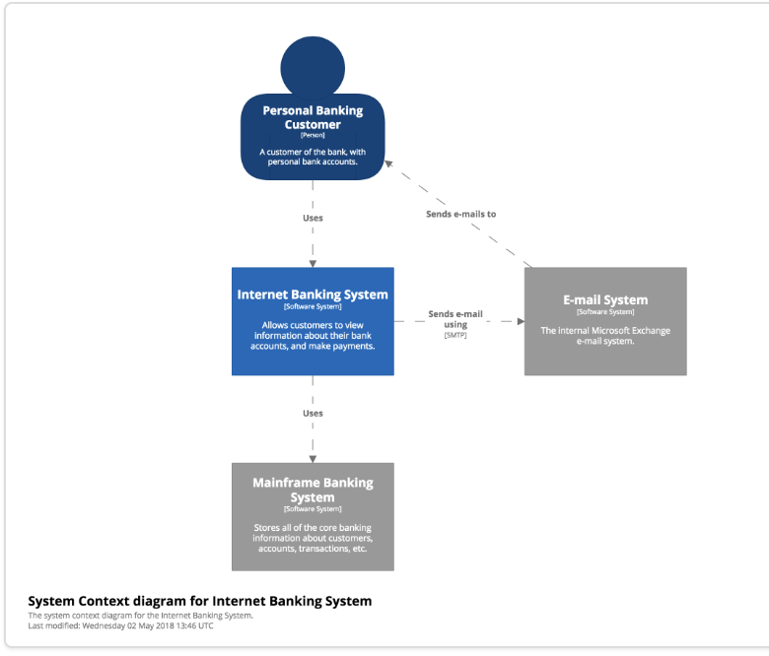
C4 - Context
Ref: Simon Brown https://c4model.com/

Slide 45
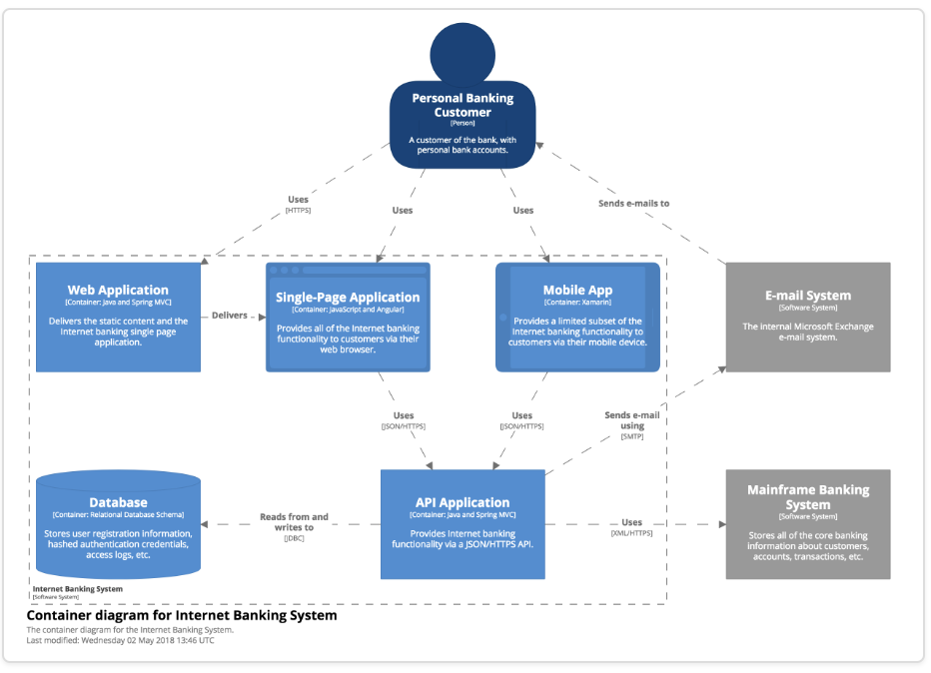
C4 - Container
Ref: Simon Brown https://c4model.com/

Slide 46
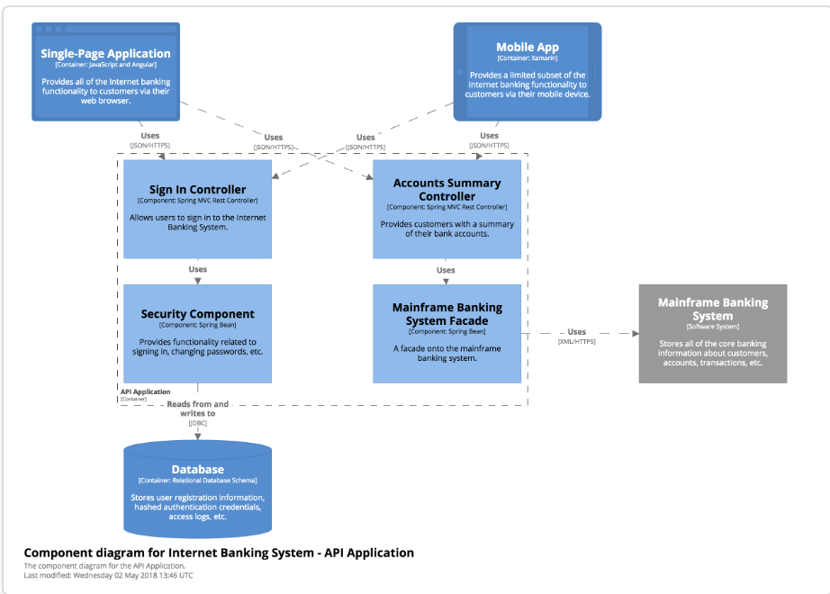
C4 - Components
Ref: Simon Brown https://c4model.com/

Slide 47
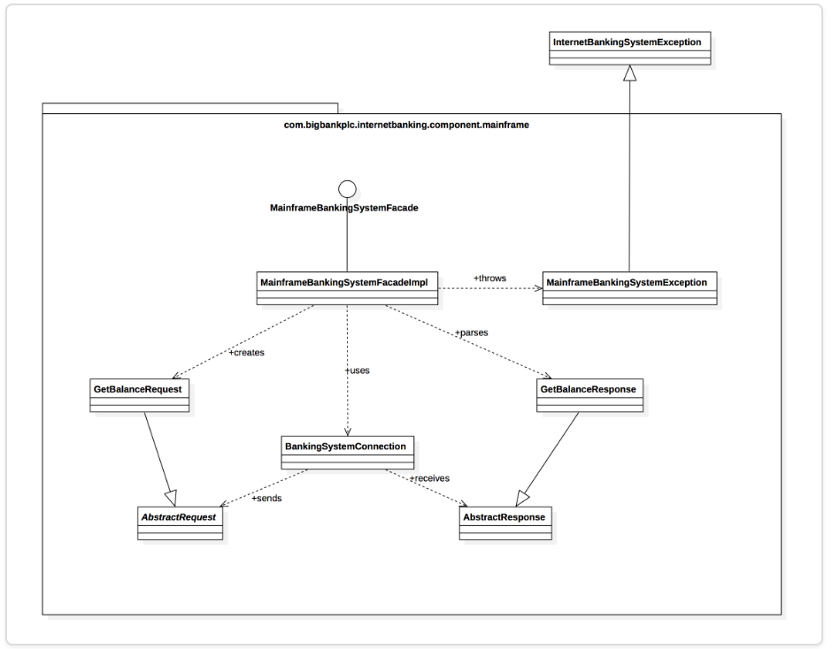
C4 – Code (Optional)
Ref: Simon Brown https://c4model.com/

Slide 48
Architecture Decision Records
http://thinkrelevance.com/blog/2011/11/15/documenting-architecture-decisions Seminal Reference (2011) – Michael Nygard - https://www.cognitect.com/blog/2011/11/15/documenting-architecture-decisions
One of the best ways to document an architecture is to think about all of the decisions that need to be made
Not all decisions need to be made at once
Not all decisions need solutions prior to a project beginning
We constantly learn new things, thus, decisions may change
Also, keeping decisions close to the code, with collaboration capabilities is desirable: https://github.com/ArchitectingSoftware/CS575-SoftwareDesign/tree/master/Lectures/Architecture-Documentation-Demo/doc
ADR
Numbered monotonically, no number ever repeats
Clear title, status and keywords for search
Context and Problem Statement
Considered Options
Decision Outcome
Supporting architecture diagrams
DEMO AT: https://github.com/ArchitectingSoftware/CS575-SoftwareDesign/tree/master/Lectures/Architecture-Documentation-Demo/doc

Slide 49
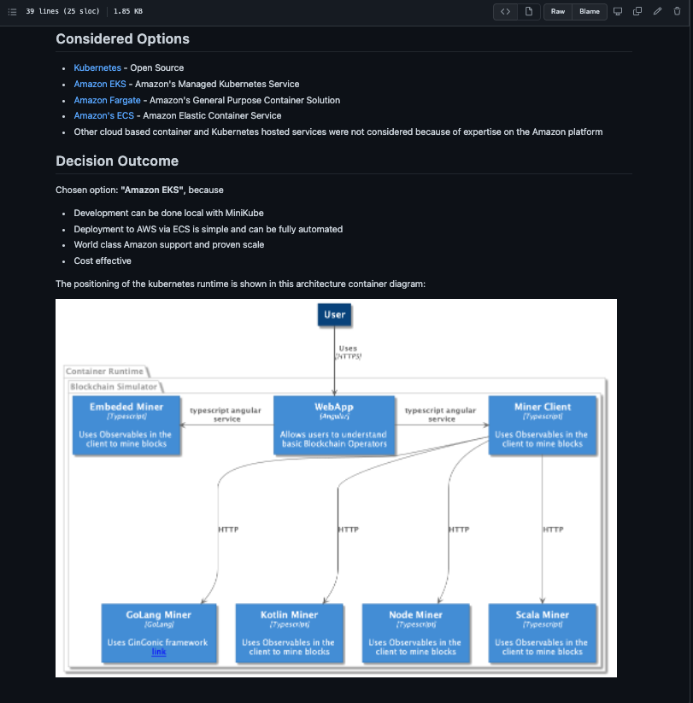
Architecture Decision Records
Think of ADRs as “Architecture as Code”
Lend themselves very well to be managed and versioned in git
Indexable/ searchable
Ephemeral – Records history of changes over time as new things are learned
ADRs complement visual models – they do not replace them.
Records alternatives and models help support the rationale

Slide 50
More on C4 Styling
See: https://github.com/ArchitectingSoftware/SE577-SoftwareArchitecture/blob/main/lectures/visualising-software-architecture-with-the-c4-model.pdf
Lots of great suggestions on C4 best practices from Simon Brown himself

Slide 51
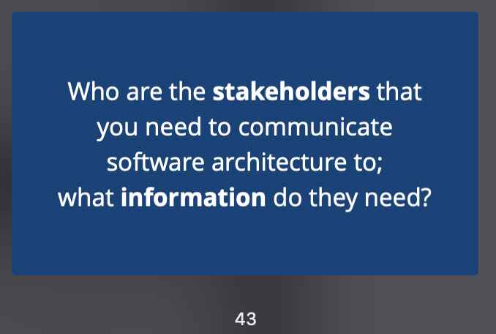
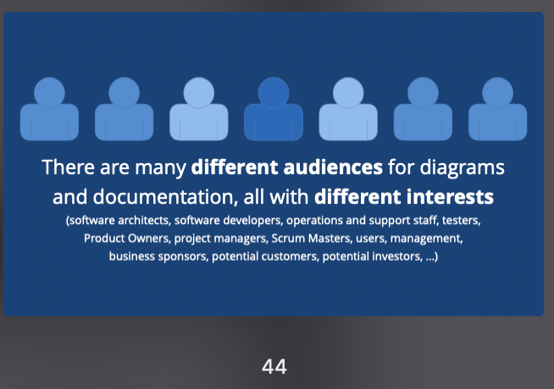
Some callouts from the attachment
https://github.com/ArchitectingSoftware/SE577-SoftwareArchitecture/blob/main/lectures/visualising-software-architecture-with-the-c4-model.pdf
I have mentioned this MANY times

Slide 52
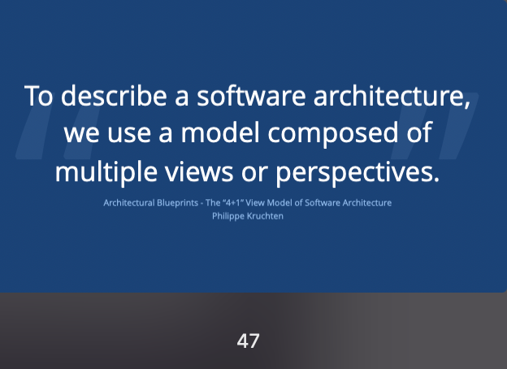
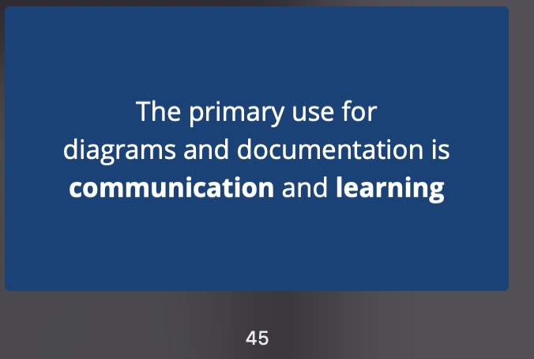
Some callouts from the attachment
https://github.com/ArchitectingSoftware/SE577-SoftwareArchitecture/blob/main/lectures/visualising-software-architecture-with-the-c4-model.pdf

Slide 53
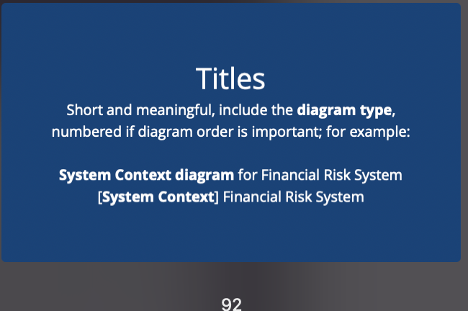
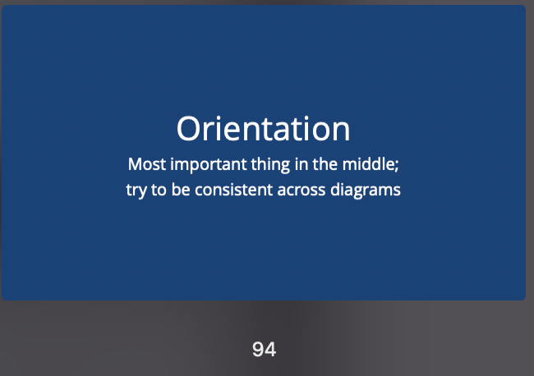
Some callouts from the attachment
https://github.com/ArchitectingSoftware/SE577-SoftwareArchitecture/blob/main/lectures/visualising-software-architecture-with-the-c4-model.pdf

Slide 54
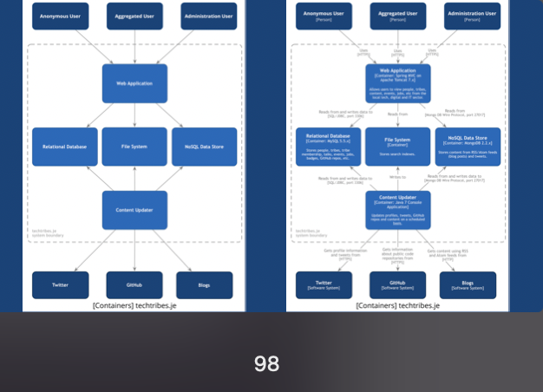
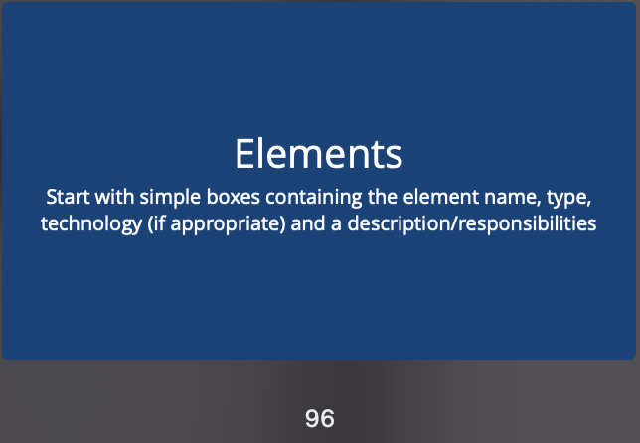
Some callouts from the attachment
https://github.com/ArchitectingSoftware/SE577-SoftwareArchitecture/blob/main/lectures/visualising-software-architecture-with-the-c4-model.pdf

Slide 55
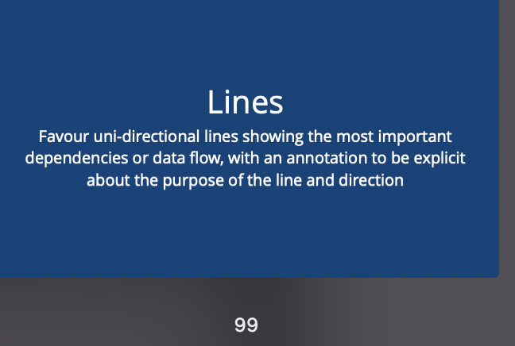
Some callouts from the attachment
https://github.com/ArchitectingSoftware/SE577-SoftwareArchitecture/blob/main/lectures/visualising-software-architecture-with-the-c4-model.pdf
Slides 99-106 Have Great Guidence

Slide 56
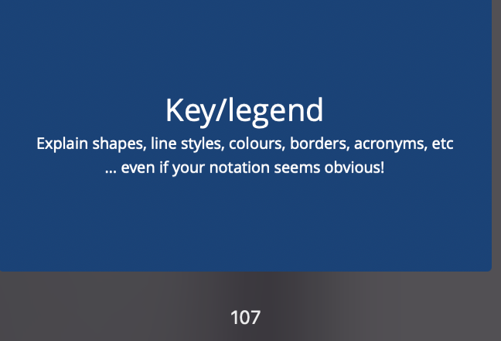
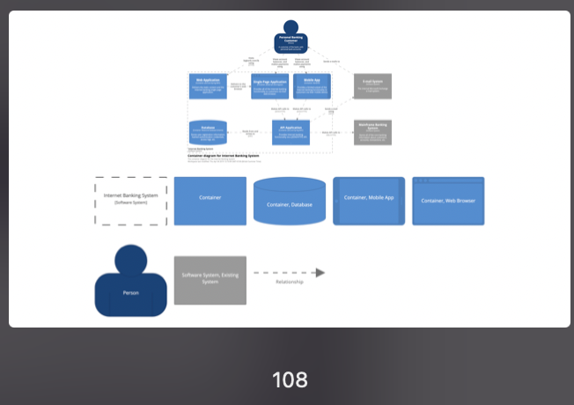
Some callouts from the attachment
https://github.com/ArchitectingSoftware/SE577-SoftwareArchitecture/blob/main/lectures/visualising-software-architecture-with-the-c4-model.pdf

Slide 57
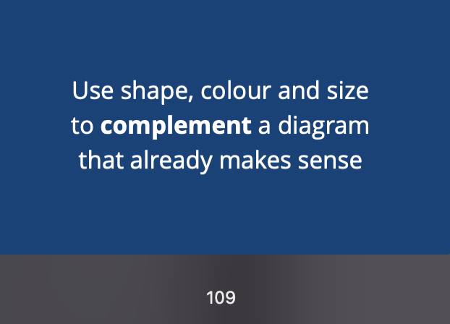
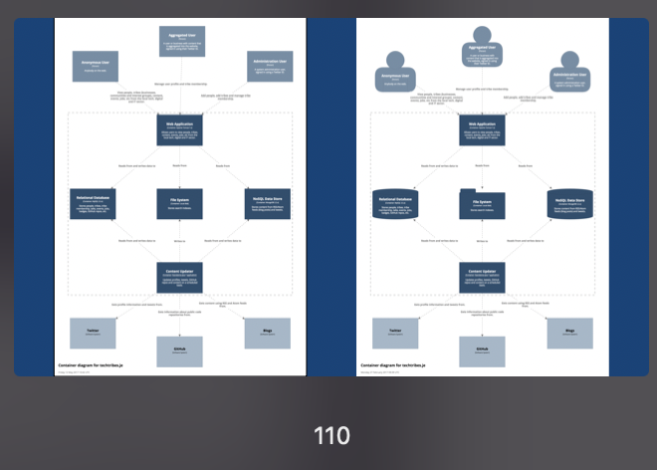
Some callouts from the attachment
https://github.com/ArchitectingSoftware/SE577-SoftwareArchitecture/blob/main/lectures/visualising-software-architecture-with-the-c4-model.pdf

Slide 58

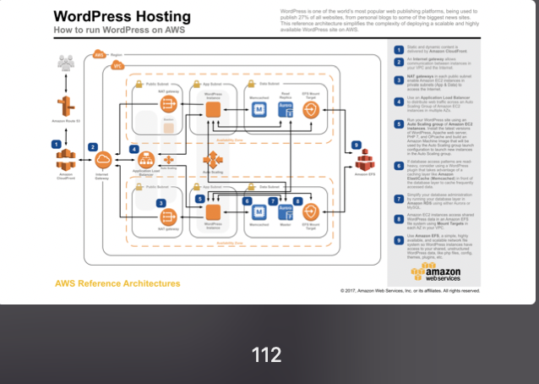
Some callouts from the attachment
https://github.com/ArchitectingSoftware/SE577-SoftwareArchitecture/blob/main/lectures/visualising-software-architecture-with-the-c4-model.pdf

Slide 59
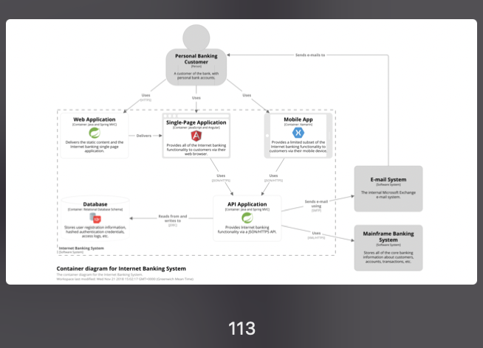
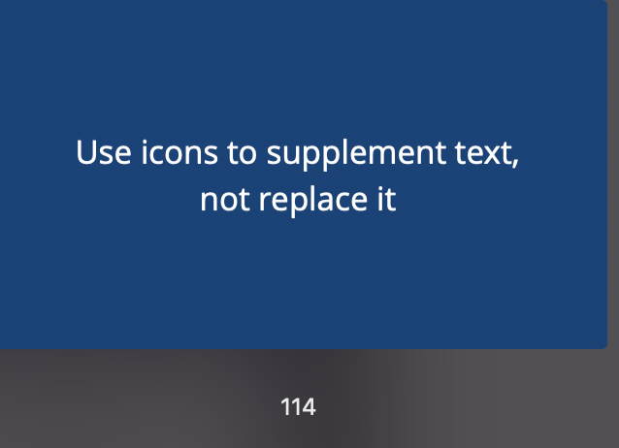
Some callouts from the attachment
https://github.com/ArchitectingSoftware/SE577-SoftwareArchitecture/blob/main/lectures/visualising-software-architecture-with-the-c4-model.pdf

Slide 60
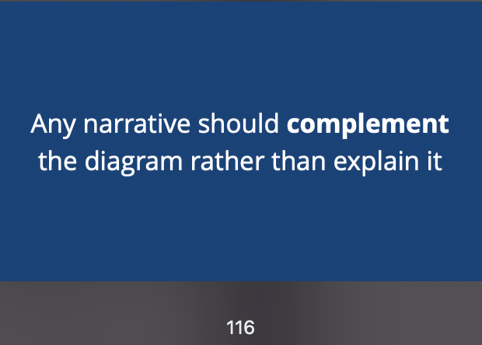
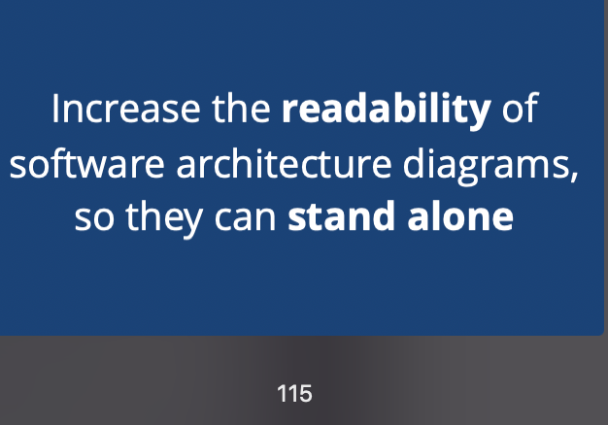
Some callouts from the attachment
https://github.com/ArchitectingSoftware/SE577-SoftwareArchitecture/blob/main/lectures/visualising-software-architecture-with-the-c4-model.pdf

